Slide 1
Electronics Workshop (6)
2017 June 23
Arduino Week (2)

Slide 2
Files to Cover
Works_005
Analog Input(1): Simple Reading
Works_006
Analog Input(2): Brightness control
Exercise 001
Simple Voltmeter
Works_007
Functions
Works_008
External Interrupts
Exercise 002
Button Matrix

Slide 3
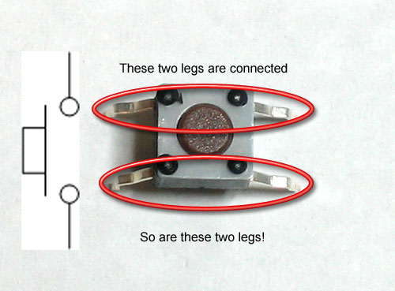
Component 1: Tactile Switch
In our case…
Going across the well means they are connected
Going across row means they are NOT connected

Slide 4
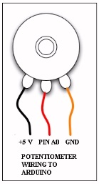
Component 2: Potentiometer

Slide 5
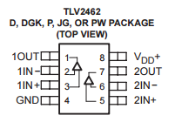
Component 3: Op-Amp

Slide 6
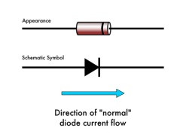
Component 4: Diode

Slide 7
Other Components
10k Resistors
1k Resistors
Tactile Buttons
LEDs

Slide 8
Recap Digital I/O…
E-Mail Sender
Combination of Python and Arduino
Two Switches on Arduino controls sending/termination

